Slide 1
What is the cow of the future, and how will we create her?
John B. Cole, PhD
PEAK Sr. VP for Research & Development
john.cole@urus.org

Slide 2
Topics for discussion
Why do we need a cow of the future?
How will we create that cow?
What will the cow of the future look like?
Closing thoughts

Slide 3
Why do we need a cow of the future?

Slide 4
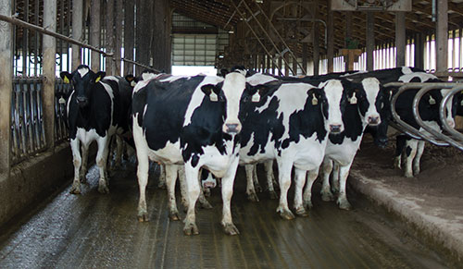
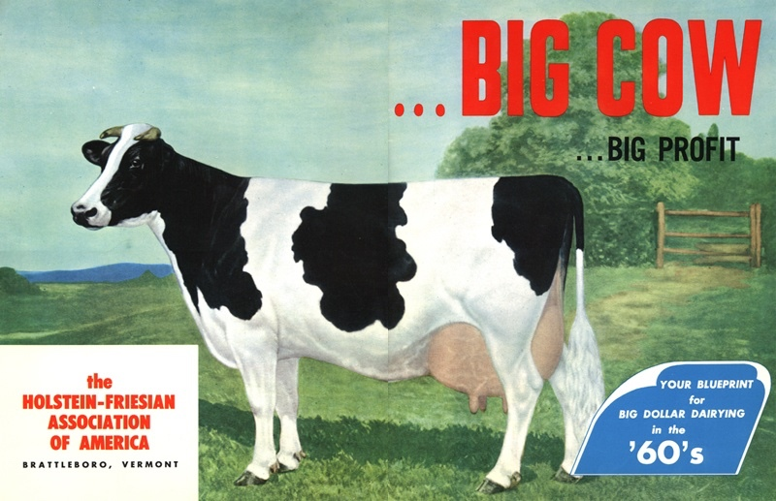
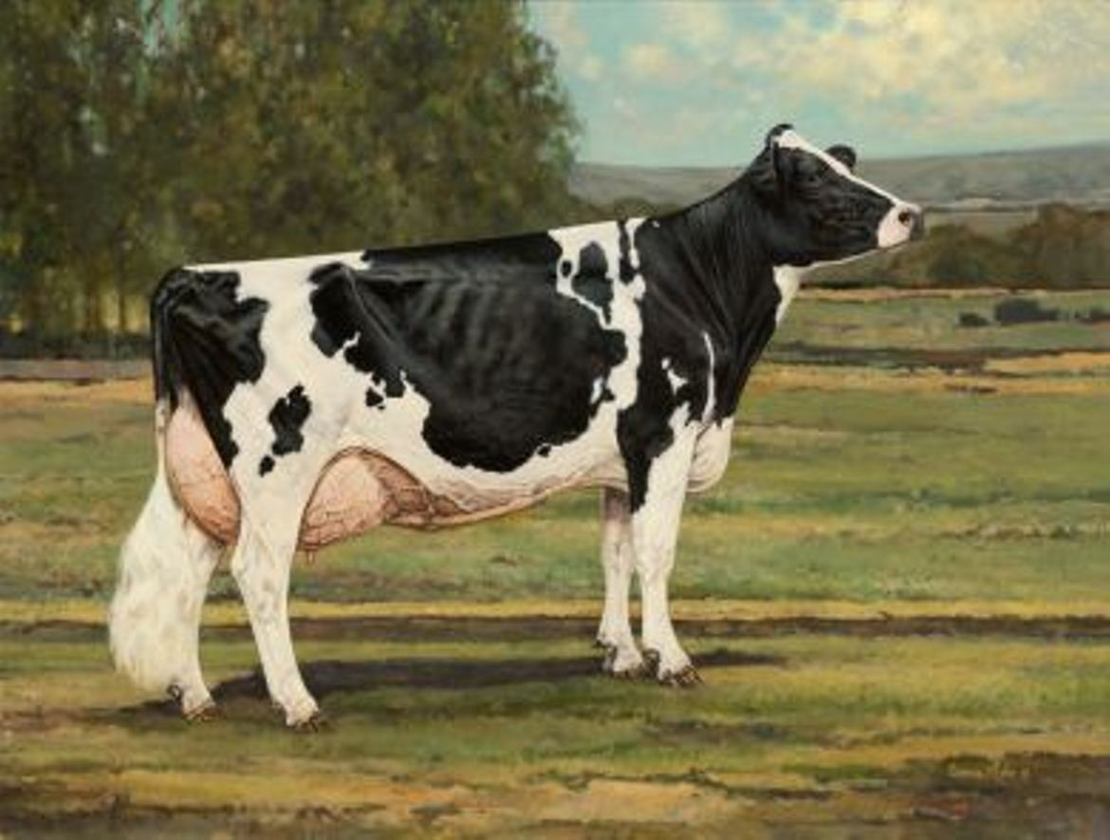
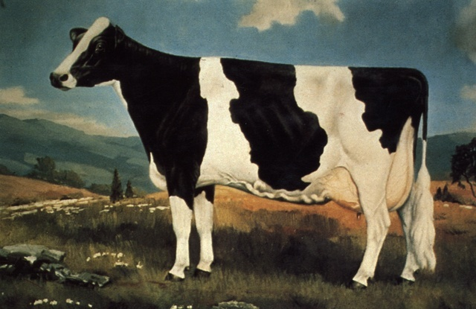
You can’t milk the same cow forever
U.S. Ideal Holstein – 2020s?
U.S. Ideal Holstein – 1960s
U.S. Ideal Holstein – 2012
U.S. Ideal Holstein – 1970s

Slide 5
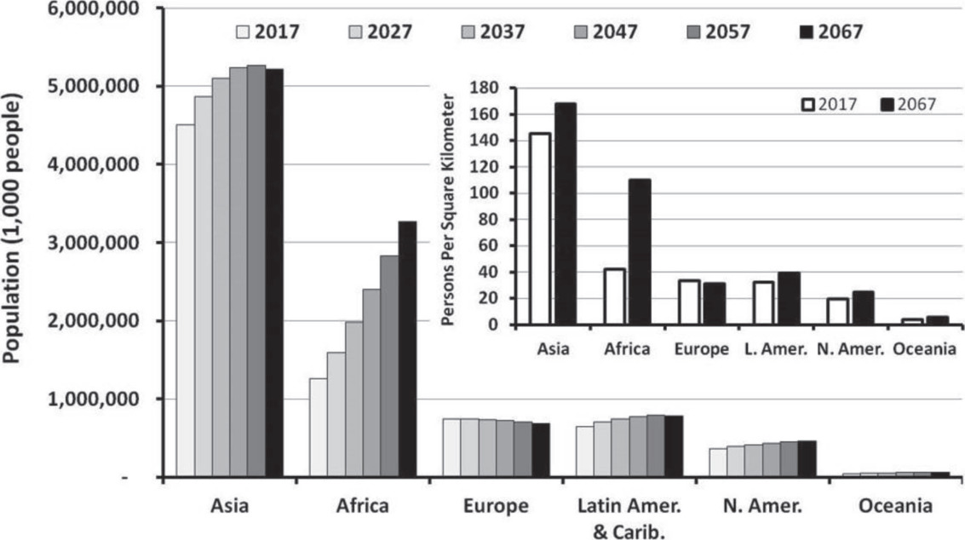
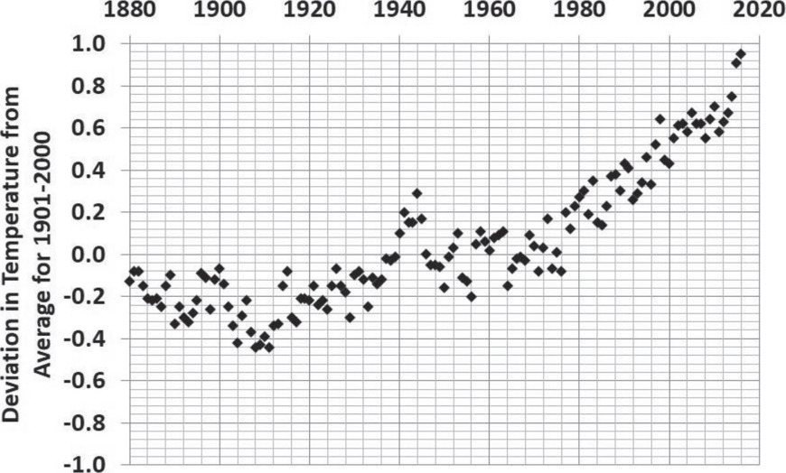
We’re under pressure to do more with less
Source: Britt et al. (2018; https://www.journalofdairyscience.org
/article/S0022-0302(18)30181-4/fulltext).

Slide 6
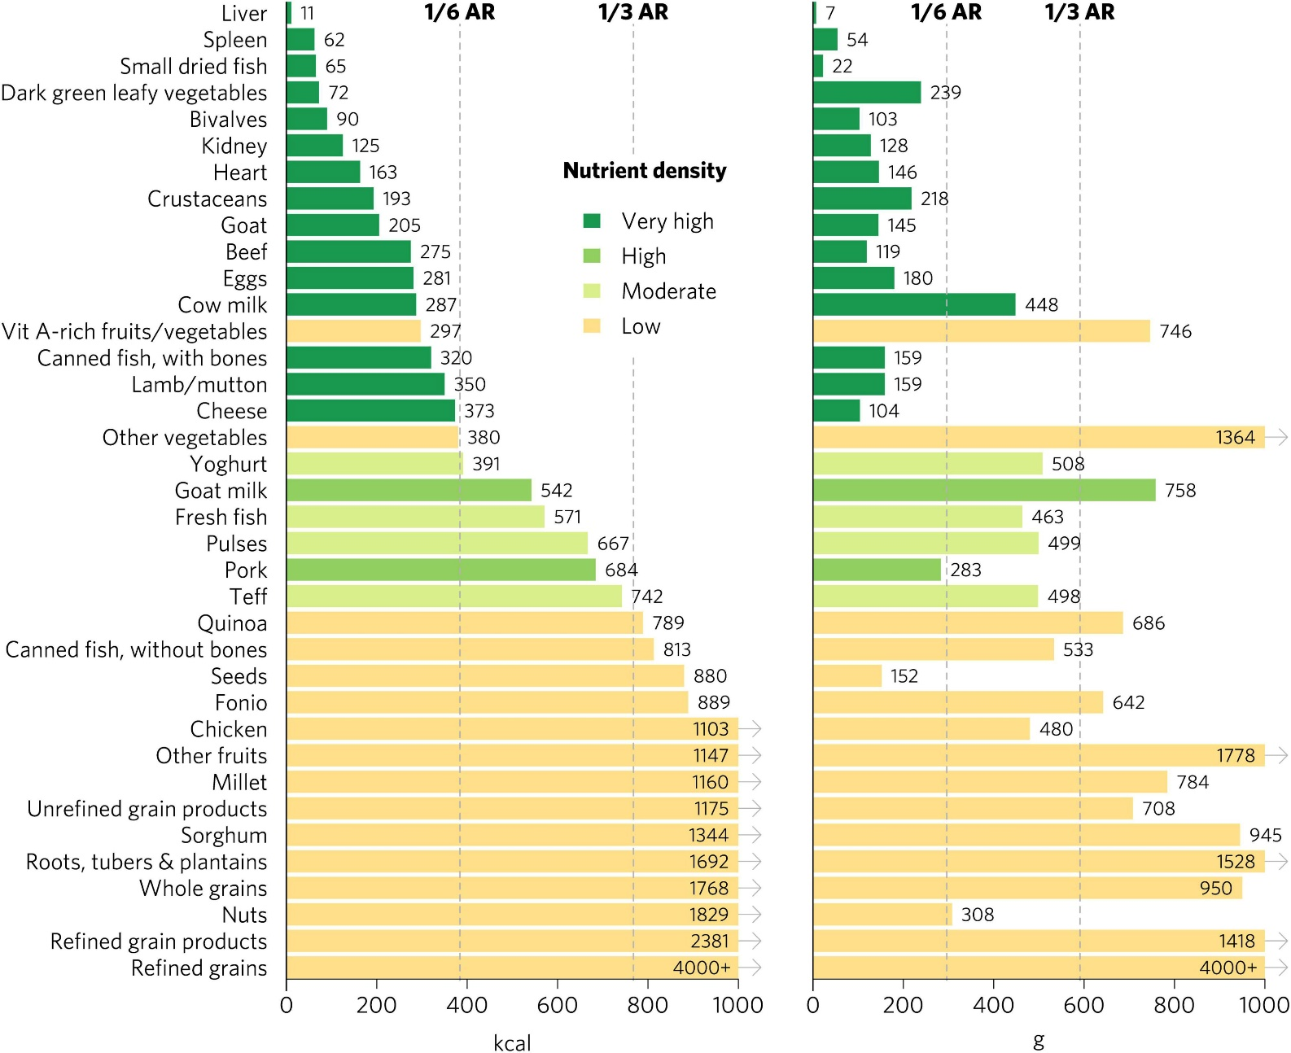
Animal foods are dense in nutrients
Source: Angeline et al. (2022; https://www.frontiersin.org/articles/10.3389/fnut.2022.806566/full).

Slide 7
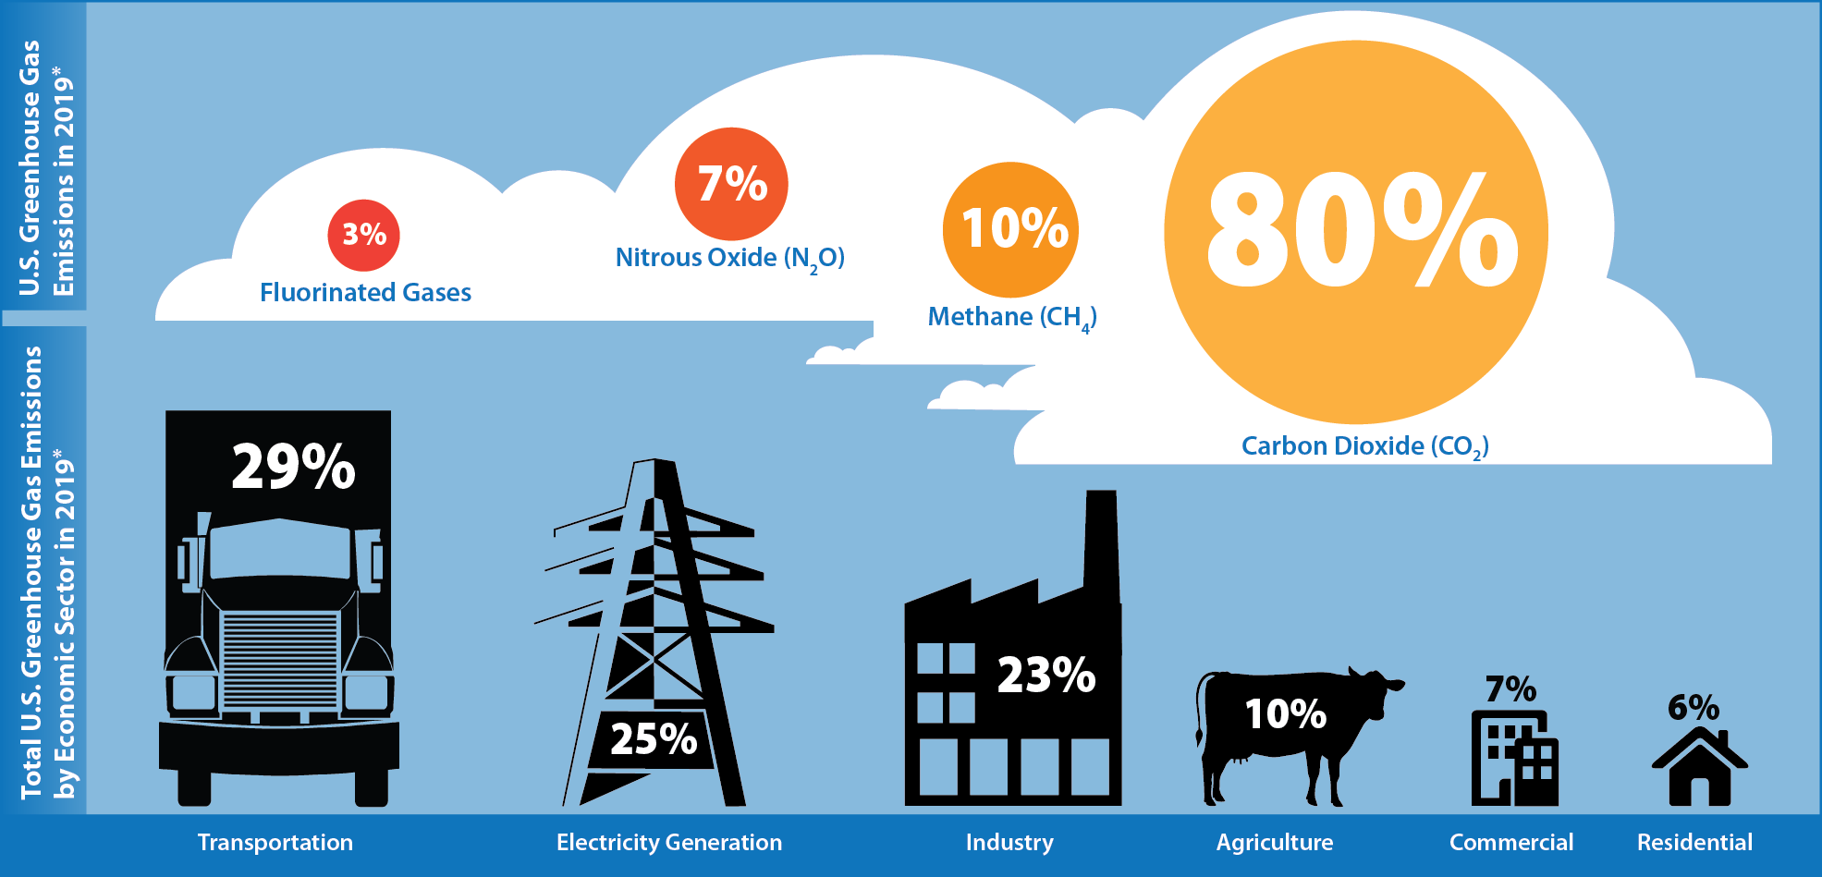
Dairy has a role to play in climate action
Source: U.S. EPA (2021; https://cfpub.epa.gov/ghgdata/inventoryexplorer/).

Slide 8
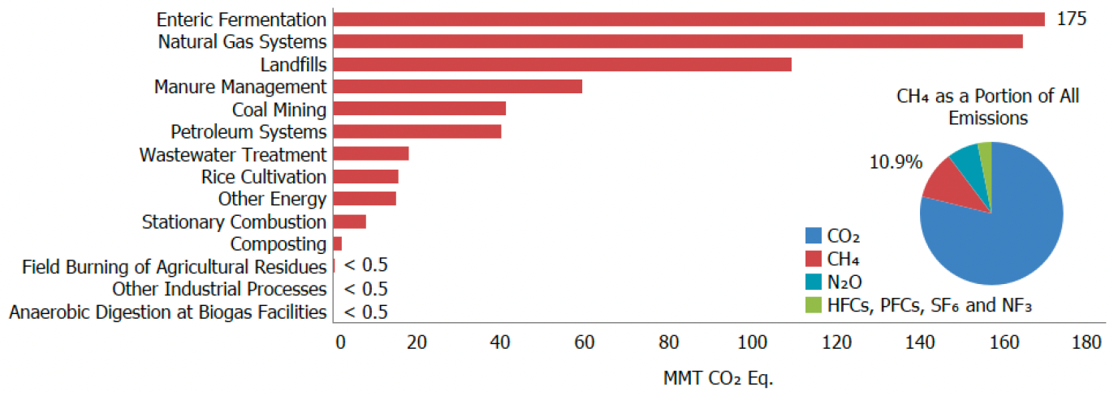
Cows make lots of methane
Source: U.S. EPA (2022; https://cfpub.epa.gov/ghgdata/inventoryexplorer/).

Slide 9
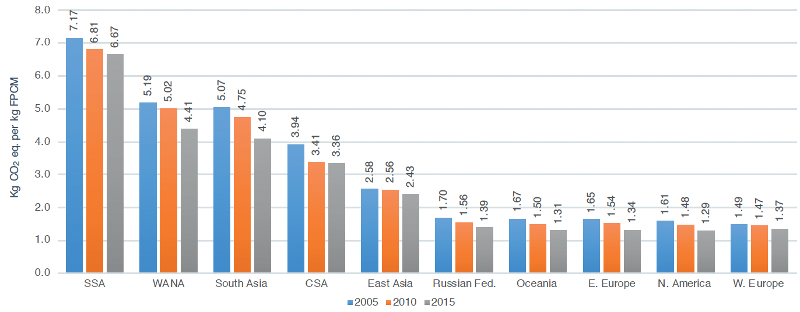
Methane output per kg of milk is falling
Source: FAO (2019; https://www.fao.org/3/CA2929EN/ca2929en.pdf).

Slide 10
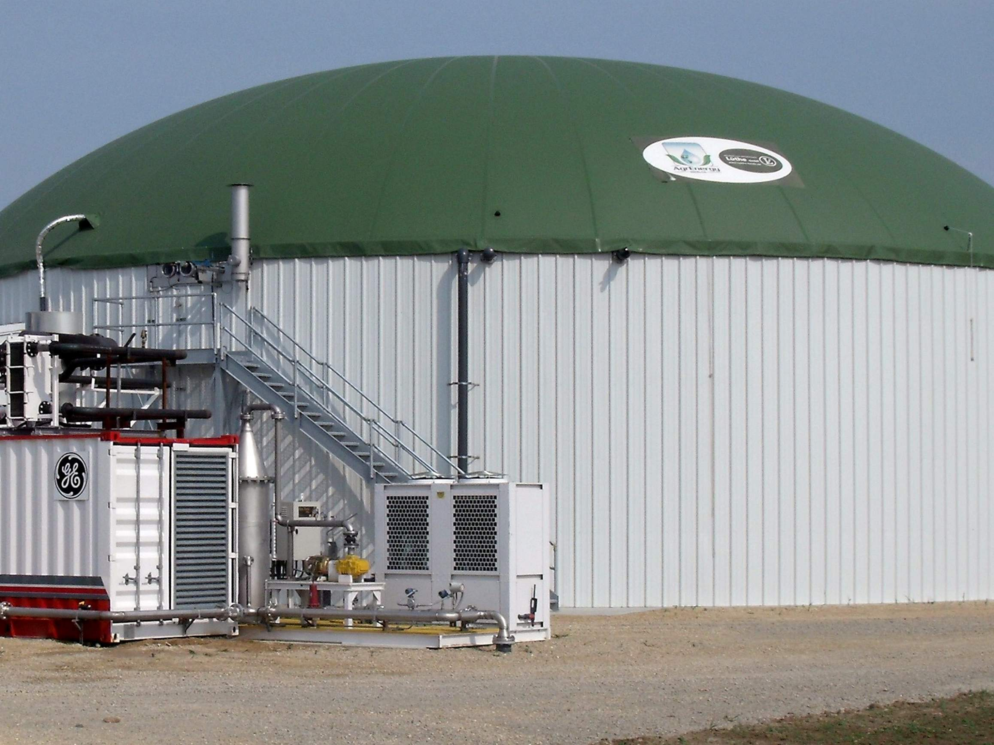
The bottom line
There are some easy
wins on the table
The carbon economy
is coming
If we don’t lead,
others will

Slide 11
How will we create the cow of the future?

Slide 12
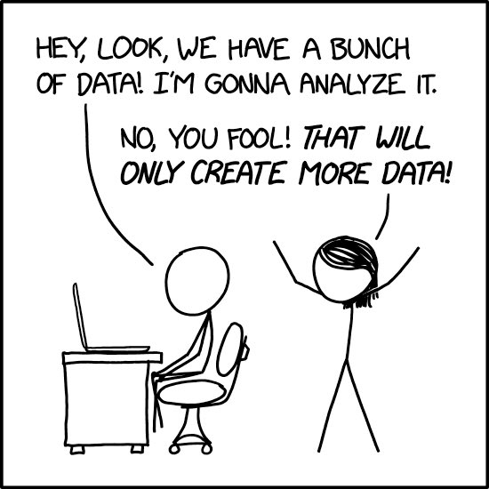
Source: https://xkcd.com/2582.

Slide 13
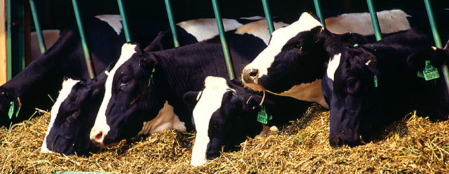
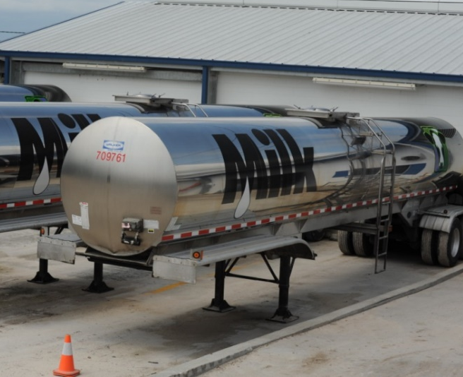
Traditional phenotyping scheme
Current milk recording
Many farms participate
Low-intensity phenotyping
(few measurements per cow)
Well-suited to traits with
low recording costs
Source: ARS, USDA
Source: North Florida Holsteins
Source: John B. Cole

Slide 14
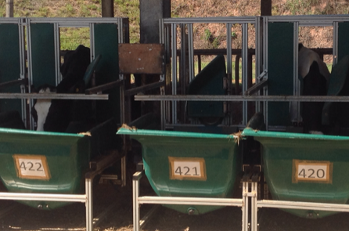
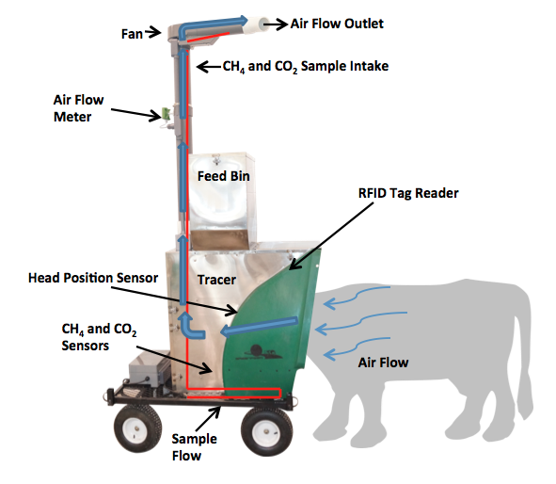
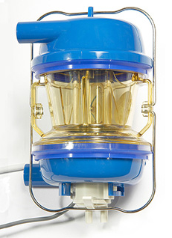
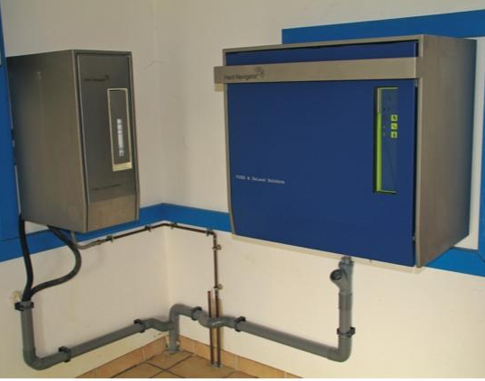
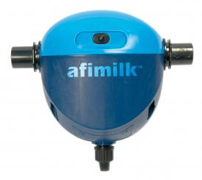
Alternative phenotyping scheme
Few farms
Intensive phenotyping
(many measurements per cow)
Ideal for expensive-to-
measure traits
Source: John B. Cole
Source: http://c-lockinc.com/
Source: http://www.afimilk.com/
Source: http://goo.gl/wu8YtR

Slide 15
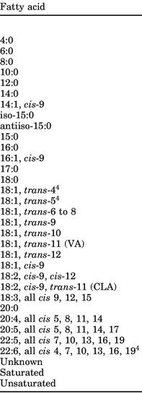
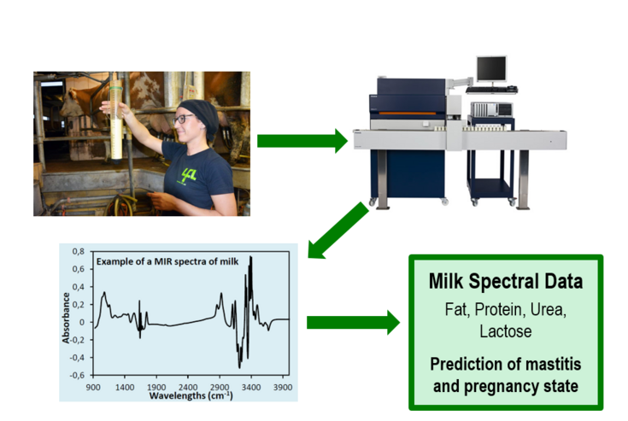
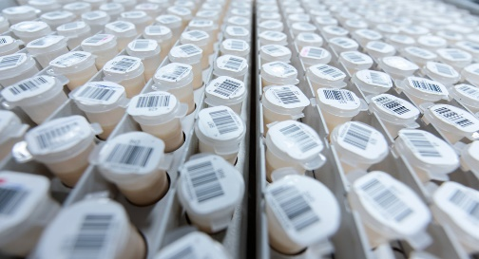
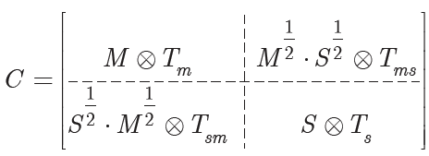
What about the milk sample?
Test-day sample
+
Milk Testing
Laboratory
Absorbance
Spectrum
Laboratory
Measurements
use to…
Predict Phenotypes
for All Tested Animals
Prediction
Equation

Slide 16
Genomics is helping us go faster

Slide 17
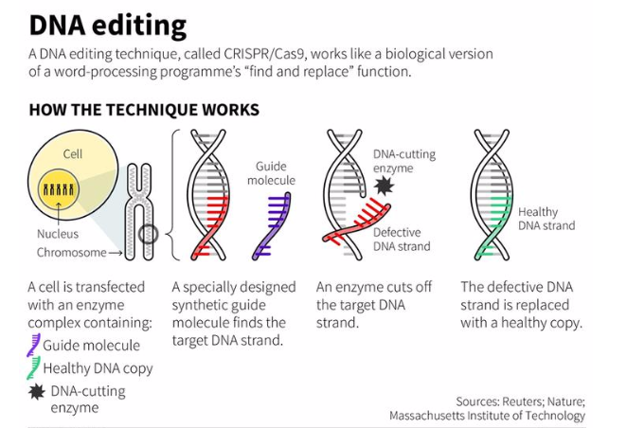
What is gene editing?
Molecular biology tools for precisely changing animal genomes
  Polled
  Slick
  Disease resistance
  Marbling/tenderness?
Does not involve the transfer of genes among species

Slide 18
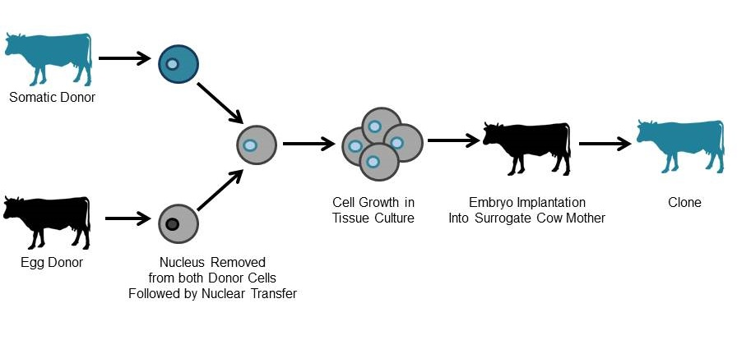
Cloning
The process of creating
a genetically identical duplicate of an animal
Of limited use in the
genomic era because generations turn over
so quickly
Often used in combination with other technologies

Slide 19
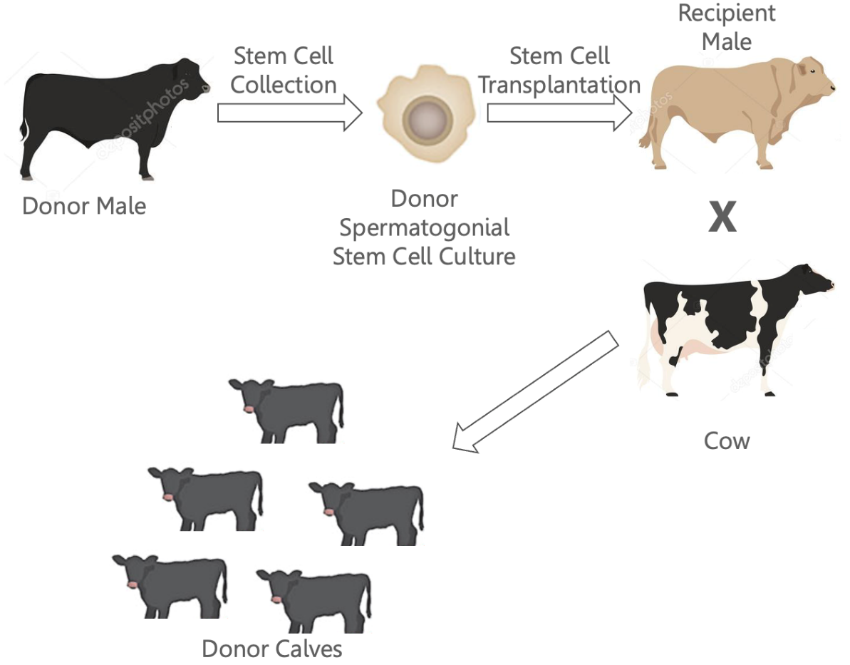
Surrogate sire technology
The reproductive system of one animal can be used to propagate the genetics of another
Can circumvent the limited semen-production capacity of young bulls
Does not increase diversity among bulls

Slide 20
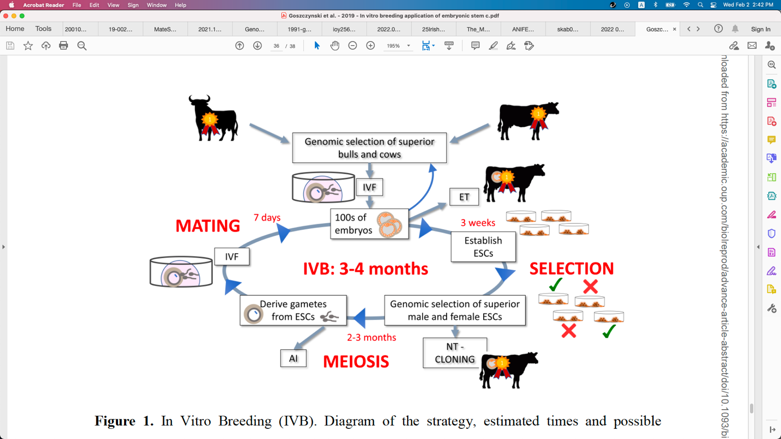
In vitro breeding
Stem cells can be taken from embryos and turned into sperm and eggs
Those can be used to create
a new generation of embryos in the laboratory
This increases the rate of genetic gain because the need to create live animals
is avoided

Slide 21
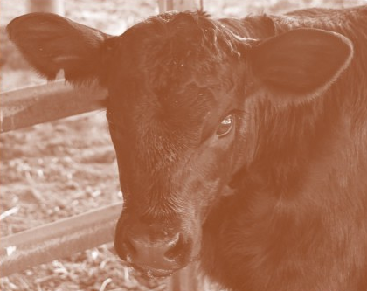
Biological sexing
A bull calf has been gene-edited to produce 75% male offspring
It might be possible to create an animal that produces only female offspring
Increase yields and decreases costs by eliminating the need for sexing

Slide 22
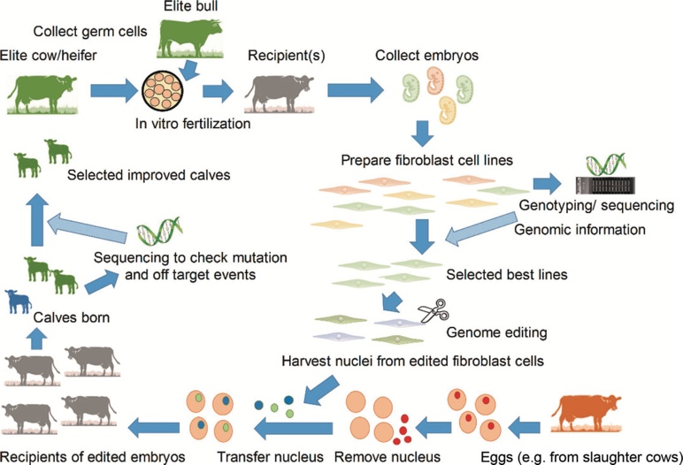
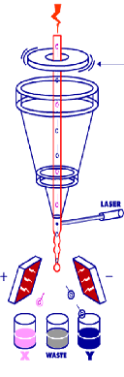
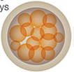

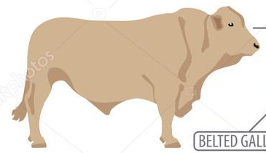
used to make…
used for
propagation
Nuclear Transfer
used with…
Clones
Sexed Semen
to create bulls for…
Embryo Transfer
Produce calves
to create bulls for…
Biological Sexing
used to create edited cell lines
to make elite males…
can introduce new traits
Surrogate Sires
Gene Editing
In Vitro Breeding

Slide 23
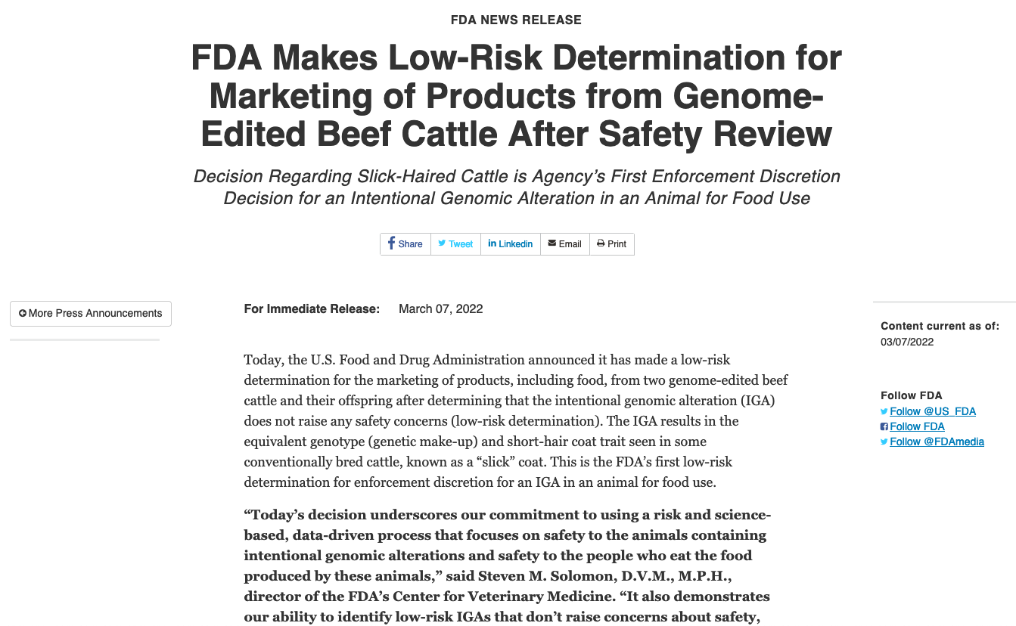
Breaking news!
There is now a path to market in the US!
Retailers are not obligated to sell a product, and consumers are not obligated to buy it
Consumers are receptive to welfare-based applications of the technology

Slide 25
What will the cow of the future look like?

Slide 26
What’s the best cow we can make?
PTA(NM$) = $3,652

Slide 27
What do 50 y of genetic progress look like?
Trait | 50-year progress | 2017 average | 2067 average | Cost of Production
Milk (pounds) | +9,329 | 27,055 | 36,384 | 50/cwt?
Fat (pounds) | +531 | 1,008 | 1,539
Protein (pounds) | +342 | 825 | 1,167
Productive life (months) | +65 | 26 | 91
Body size (pounds) | –230 | 1,500 | 1,230
Udder composite | +2.65 | 0 | 2.65
Daughter pregnancy rate (%) | +26 | 29 | 55
Cow conception rate (%) | +42 | 35 | 77
Heifer conception rate (%) | +21 | 57 | 78
Residual feed intake (pounds) | -11,150
Methane intensity (%) | -24-24

Slide 28
What are we actually trying to improve?
Feed Intake
Calves produced
GHG emissions
Lifetime profit
“Efficiency”?
“Sustainability”?
“Profitability”?
Body size
Longevity
Live weight
Microbiome
Body condition score
Mobility
Income over feed cost
Milk composition
Mid-infrared milk spectrum

Slide 29
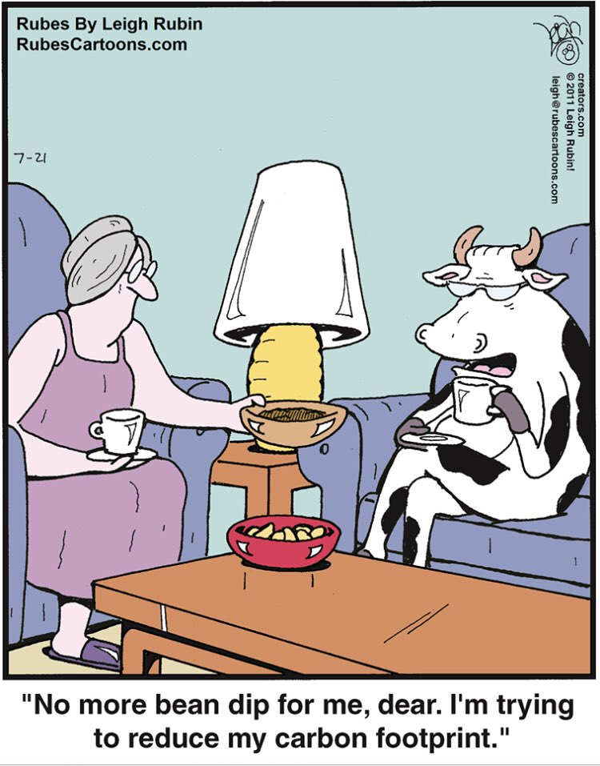
What do I think she’ll look like?
Efficient
Smaller and rounder
Long-lived
Fertile
More solids
Heat-tolerant
Polled
Robust
Desirable carcass

Slide 30
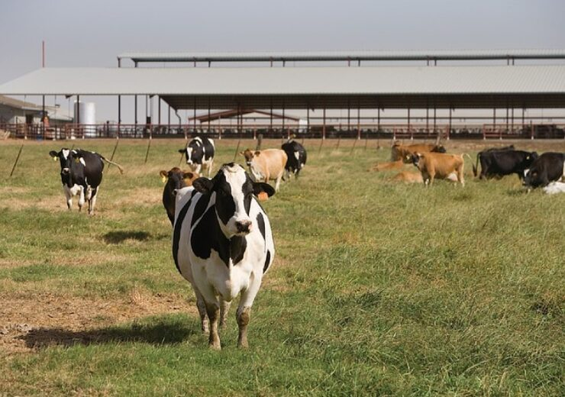
Is this the best cow for Argentina?
Each country has a different climate, different feeds, and different traditions
The right cow for North America might not be the right cow for Argentina
What do you need us to help you improve in your herd?

Slide 31
Some closing thoughts

Slide 32
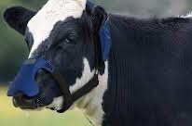
Do we know what we don’t know?
Will new technologies hold up to wear and tear in the field?
Are data networks available where they’re needed?
Can farmers get end-user support when they need it?

Slide 33
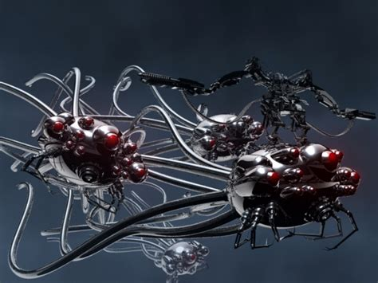
Who will watch the watchers?
Many new tools are black boxes
Who will validate their performance?
What are the gold standards for comparison?
How “good” is good enough for decision-making?

Slide 34
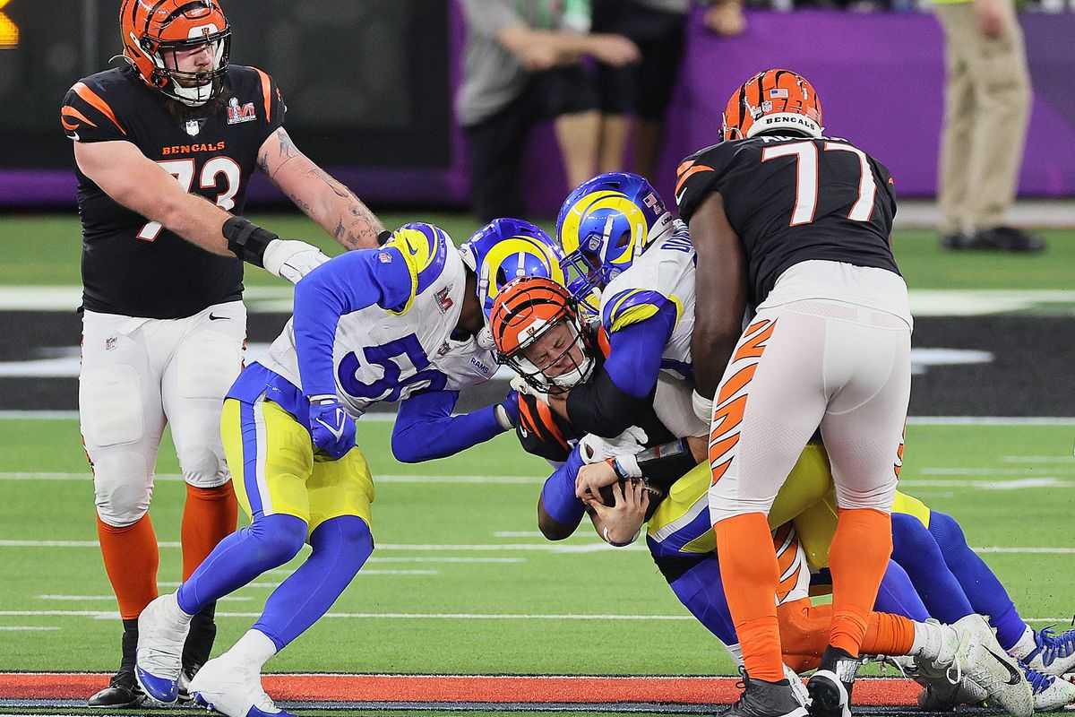
This is a team sport
Genetic improvement programs need lots of people working together
New technologies aren’t magic, and they can’t do everything
We can’t forget that our consumers are on the team, too, and what they think matters

Slide 35
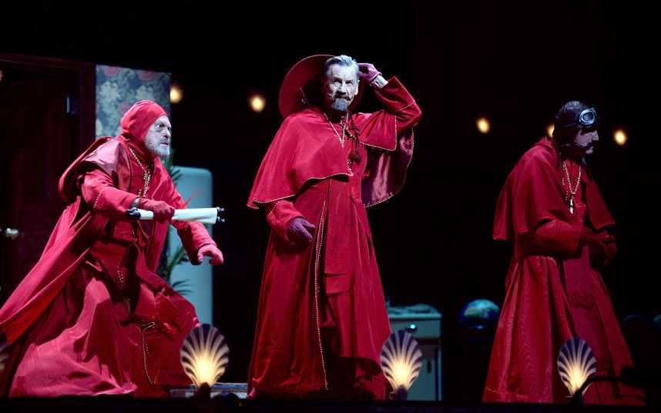
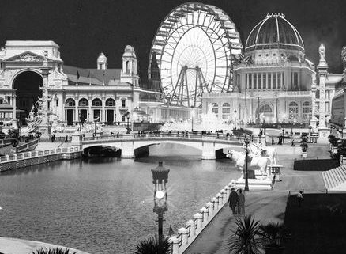
Conclusions
The world around us is changing so we need to change, too
The cow of the future will need to do more with less
We have very powerful tools for creating those cows
Social license will become even more important
Questions?

